Slide 1
Dragon game
Presented by
Minu Mahato (18403060027)
Anusika rani (18403060008)

Slide 2
Languages used
Html
Css
Java script

Slide 3
Introduction to game
As mentioned earlier we have used html ,css and java script to build this game.
In this game we have two characters Dragon and Dino.
This game features increment in score when Dino dodges Dragon.
In case Dino crashes with dragon the game comes to end i.e game over.
An addtionaly a sound can be heard when the game is over.

Slide 4
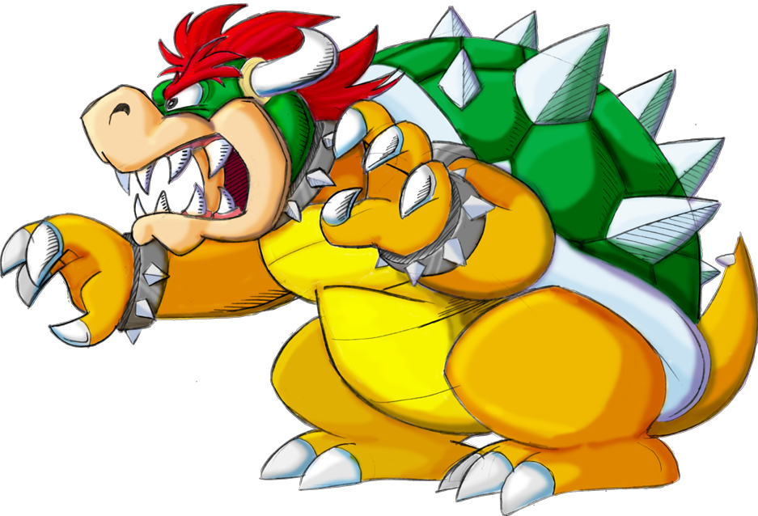
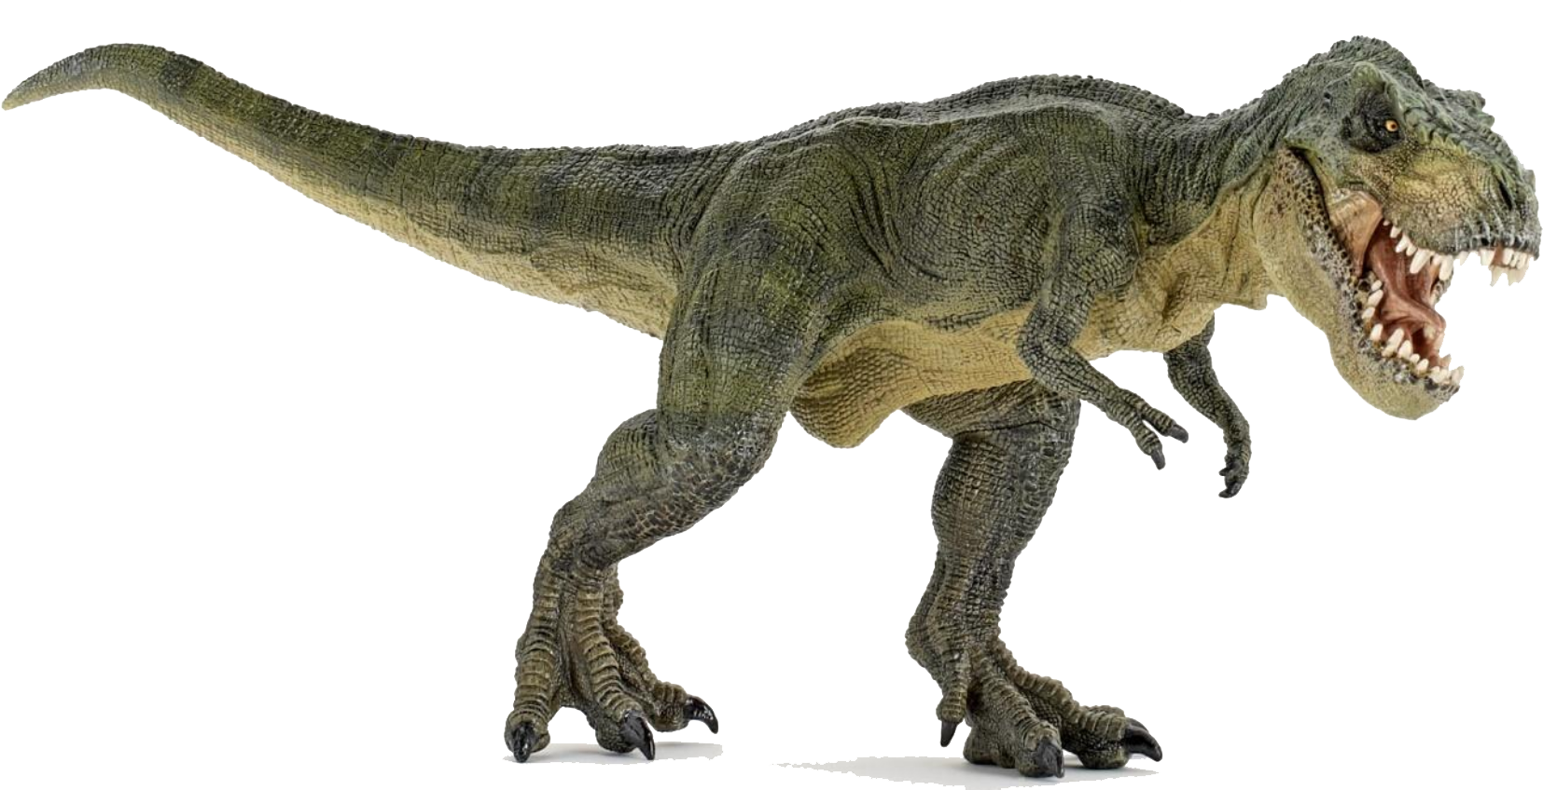
Character introduction
Dino
Dino is the protagonist of this game .
Dragon
Dragon is the antagonist of this game.

Slide 5
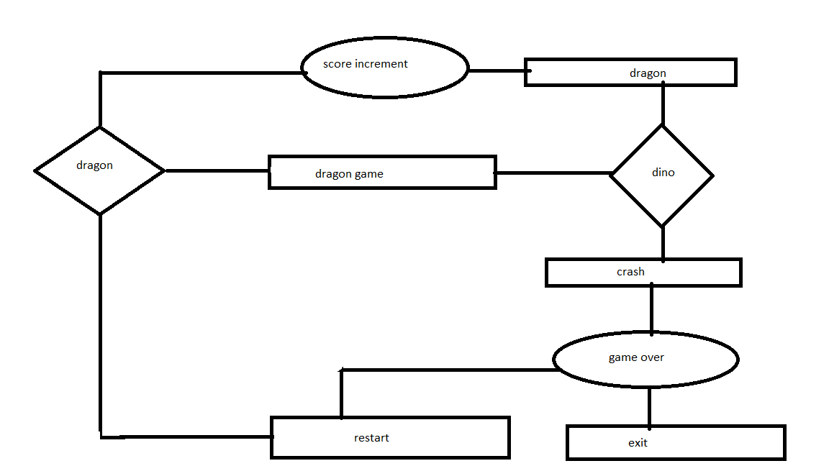
Er diagram

Slide 6
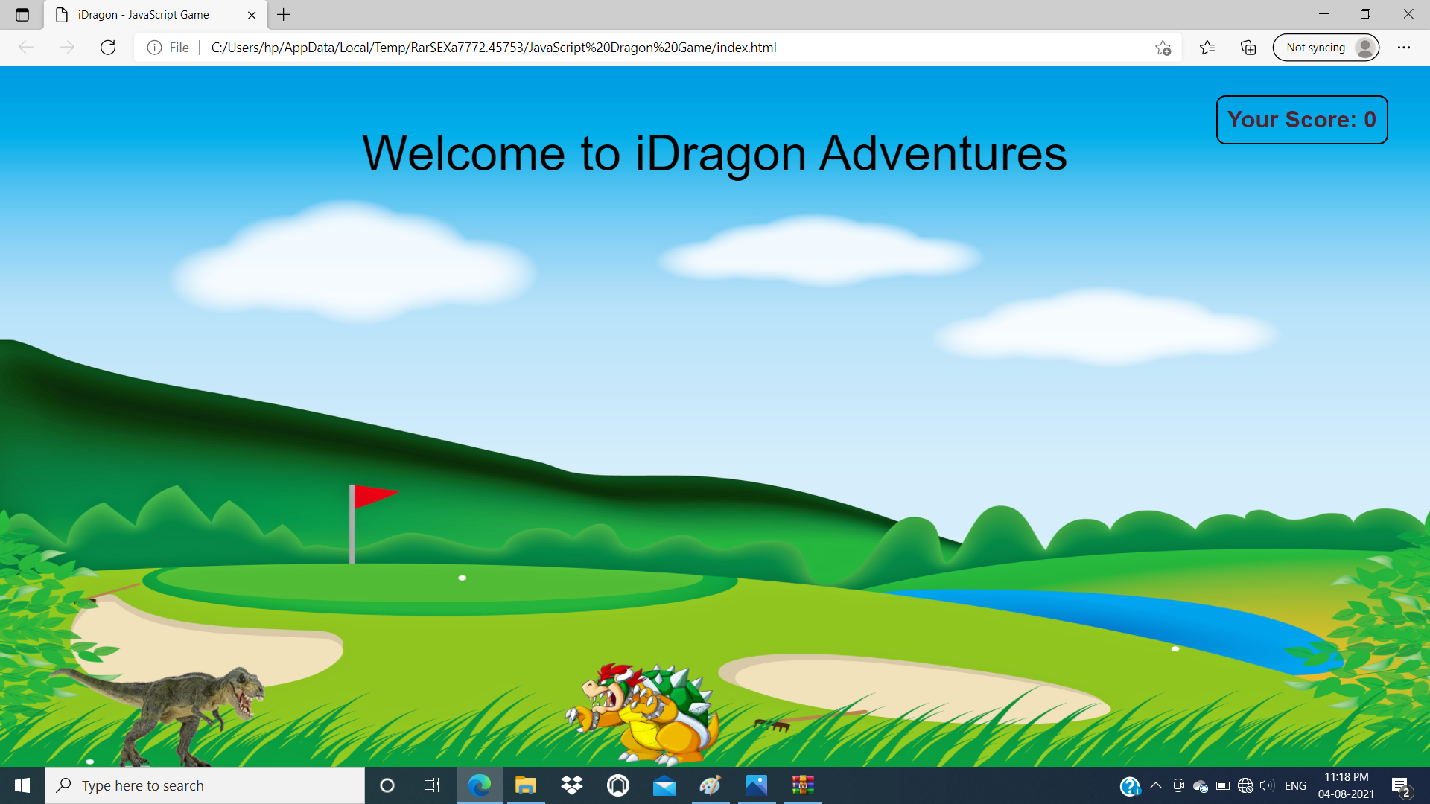
Initial stage

Slide 7
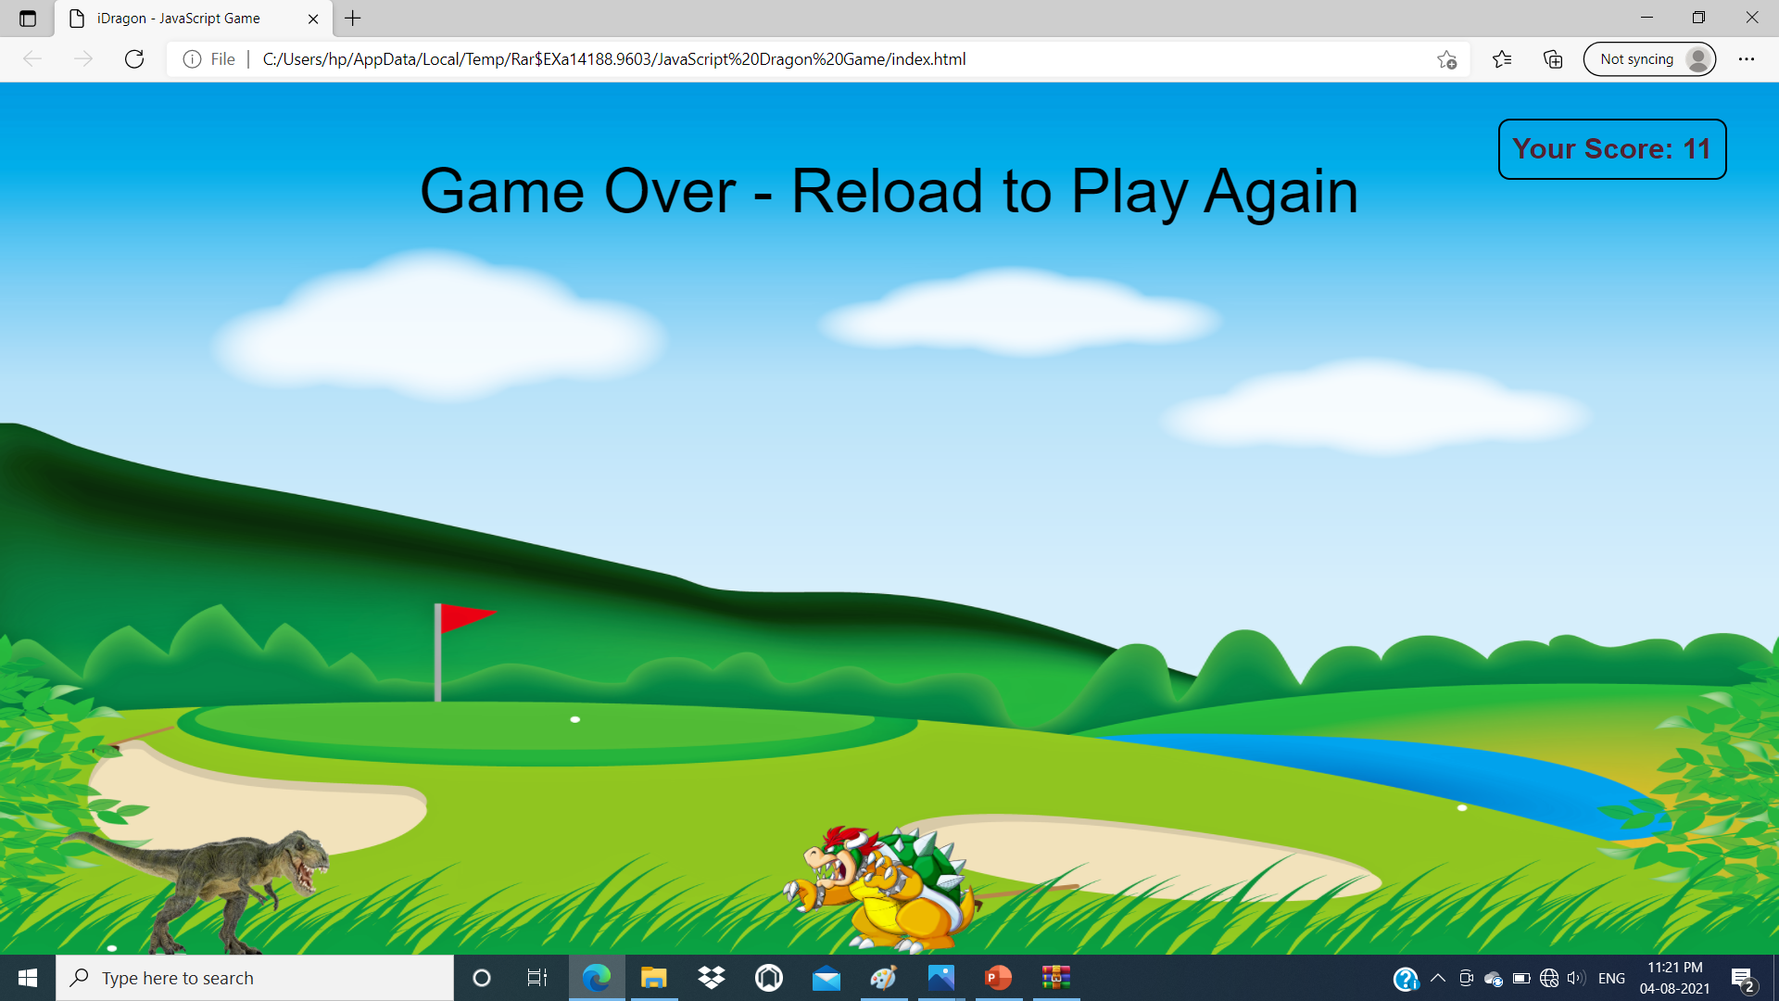
Final stage

Slide 8
Limitations and conclusion
Limitations
This game can only be played be one player .
This game does not have multi level option .
This game does not support any achievement or high score record .
Concluding this project we learned about game development using HTML ,CSS and JAVA SCRIPT.
this game can be helpful in increasing your reaction speed although this game is nothing like a big short but with little step in the big world of game development we have learned a lot.
We are looking forward to developing more of such game that can help us increase our knowledge the field of game development.

Slide 9
Resources used
W3school.com
Youtube
Tutorials point.com
Image and music from google

Slide 10
Thank you!!!
Thanking to respected faculty member for giving me the opportunity to represent our ideas and and views on this information topic this presentation immensely enhances my knowledge .

